Slide 1
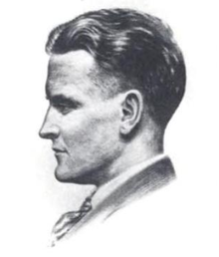
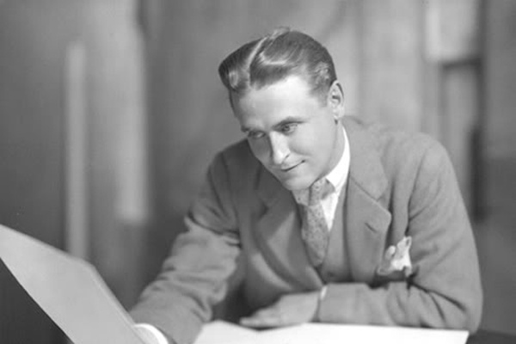
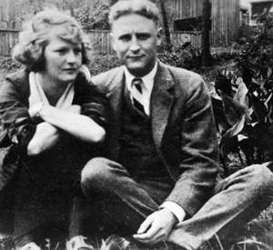
The Jazz Age The Great Gatsby takes place during the summer of 1922. Fitzgerald coined the phrase, "the Jazz Age" that same year to describe the flamboyant—"anything goes"—era that emerged in America after World War I.

Slide 2
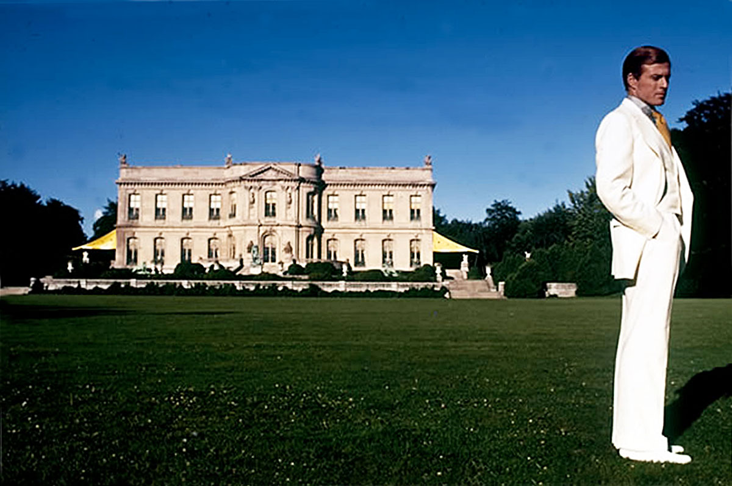
Themes
The Great Gatsby
American Dream
Shallowness and Detachment
Geography = Social class
Love
Loneliness/Isolation

Slide 3
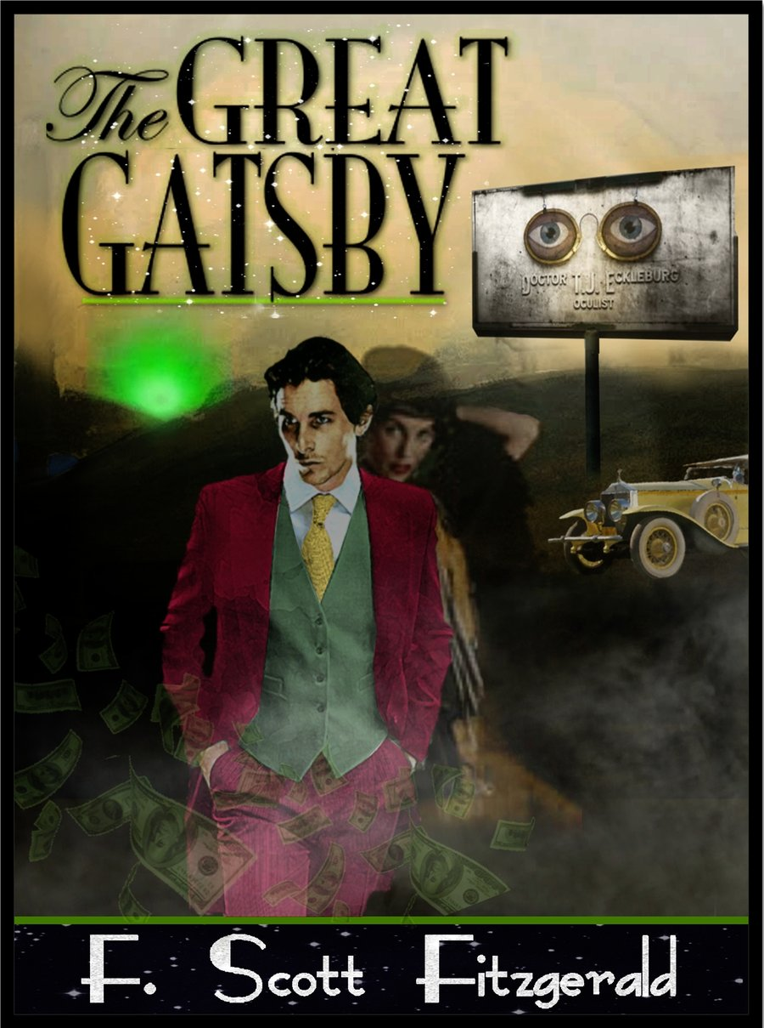
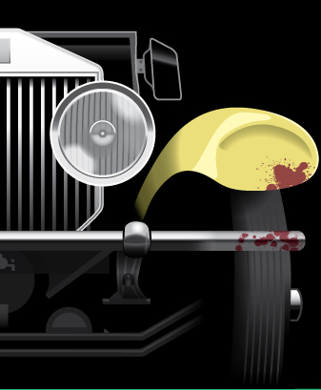
The Great Gatsby
Symbols
The green light
East and West Egg
Valley of Ashes
Eyes of Dr. TJ Eckleburg

Slide 4
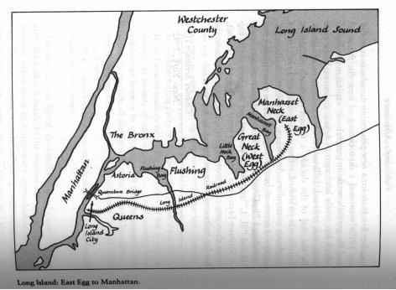
Parallelism
West Egg/East Egg & Valley of Ashes
Nick & Gatsby
Daisy & Myrtle

Slide 5
Setting:
1922, outskirts of New York City

Slide 6
The Treatment of Time??
-Chronological/flashback
-1st person narrator
Reliable? Memory?
-limited point of view and
flashback
-Who has epiphany?
-Who is the hero?
“Show me a hero, and
I'll write you a tragedy.” ― F. Scott Fitzgerald

Slide 7
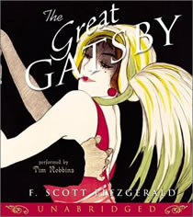
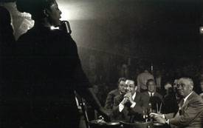
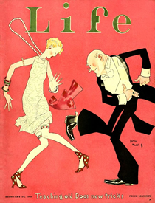
The Jazz Age/ The Roaring 20’s
The decade witnessed a titanic struggle between an old and a new America. Immigration, race, alcohol, evolution, gender roles, and sexual morality--all became major cultural battlefields during the 1920s.

Slide 8
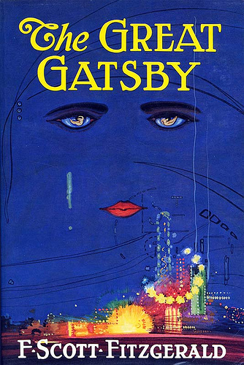
Imagery
-sights and sounds
-photographic eye??
-colors?
-TJ Eckleburg?
-green light?
-valley of ashes?
-weather?

Slide 9
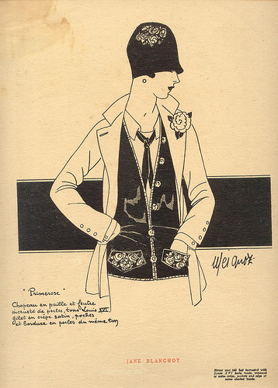
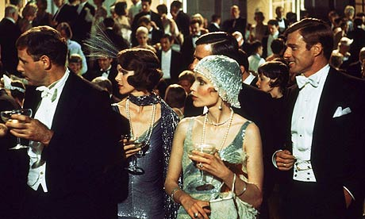
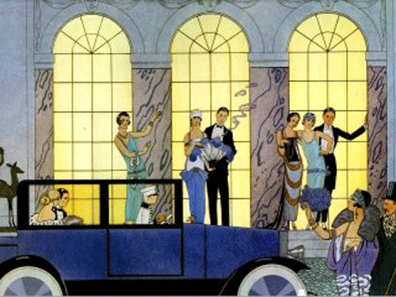
Social Controversies and Accomplishments:
Henry Ford blazed the way with his Model T; he sold more 15 million of them by 1927
Amendment 18 to the Constitution (1919)
Gangsters took control of bootlegging (illegal distribution of liquor)
Charles A. Lindbergh Spirit of St. Louis in 1927
Youthful "Flapper" women provoked older people with brief skirts, bobbed hair, and cavalier use of makeup and cigarettes.
Red Scares during the roaring twenties refer to the fear of Communism in the U.S.
1925, the "Scopes Monkey Trial,"

Slide 10
Artists and the media: film, radio, newspapers, magazines, novels, etc.
Literature: William Faulkner, F. Scott Fitzgerald, Carl Sandburg and Ernest Hemingway.
Radio: A uniquely American music form, whose roots lay in African expression, came to be known as jazz. The Jazz Age produced such greats as Louis Armstrong, Duke Ellington, George Gershwin, Cole Porter
Film: Charlie Chaplin and Rudolph Valentino

